Slide 1
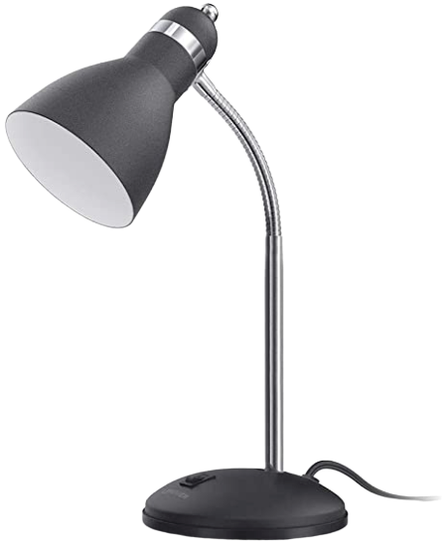
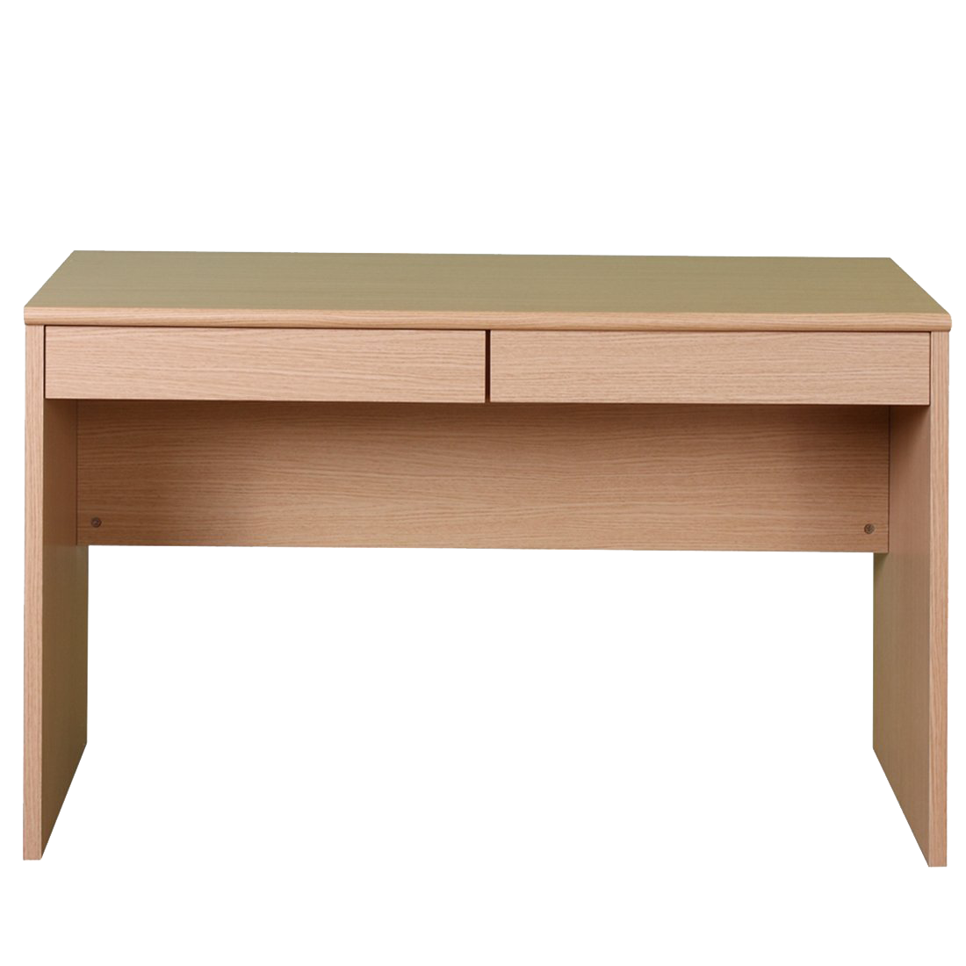
Hard work
definitely Pays off!
Welcome to
Careers and Technical Education!
Each computer links to a different website:
Teams Clever Newsela
GCF Global Acellus
Email address: rcieslak@hempsteadschools.org

